Slide 1
City of Hammond Housing Growth Study
Final Presentation
February 14, 2023
Notes:
Civix is a professional services consulting firm headquartered in New Orleans. Our work centers on urban planning, disaster recovery, housing and grant management. Our clients are based throughout the country including state and local governments in Louisiana, Florida, Texas, Tennessee, California and Michigan to name a few.
Lois Colson has a Masters in Urban Planning from the University of CA and has over 13 years of experience working in the public sector with the City of New Orleans and the New Orleans Redevelopment Authority.

Slide 2
Housing Growth Study Timeline (updated)
Element 1 Report and Presentation
Final Report and Presentation
Project Kick-off
May
June
July
August
January
Data Collection and Analysis
Element 2
Element 3
Notes:
Kick off in April. Element 1 was presented in July, 2022. Element 2 was presented in November 2022. Element III is the conclusion. The report itself will combine all three elements into one.

Slide 3
Purpose
Why a Housing Growth Study?
A Three-Phase Study
Hammond is growing. The Housing Advisory Committee (HAC) was created by a Hammond City Council resolution in 2020 to review and analyze housing needs in Hammond.
The Housing Growth Study is one of the many efforts the HAC is pursuing to meet their mandate set forth by the Council.
Element 1: Summarize demographics and identify target neighborhoods.
Element 2: Inventory and assess properties in the target neighborhoods.
Element 3: Review current practices and policies in Hammond, summarize examples from other jurisdictions, and provide recommendations to support decision making.
Identify Strategic Areas
Property Inventory
Property Assessment
Best Practices/
Recommendations
Notes:
Final meeting. Review briefly the overall purpose and phases of the study

Slide 4
Elements I and II
Data Analysis
Demographics
Housing Stock
Real Estate Sales (2017-2022)
Developed
Enhancement Areas (EAs)
Field Survey
Property Assessment
Developer Questionnaire
Identify Strategic Areas
Property Inventory
Property Assessment
Best Practices/
Recommendations
Notes:
enhancement areas on next slide

Slide 5
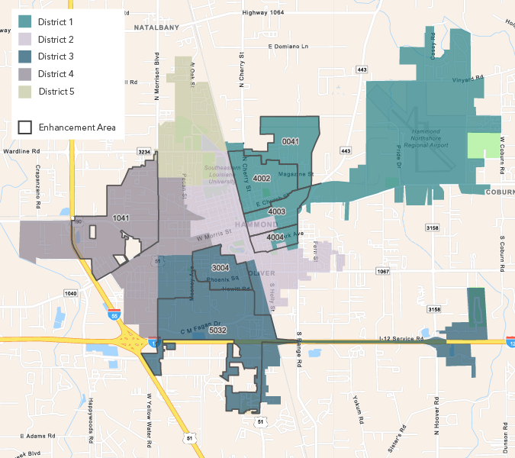
Recap
Enhancement Areas
Developed in Element I
Assessed in Element II
Enhancement Areas can be considered as priority locations to focus efforts on infill development and neighborhood redevelopment strategies.
Identify Strategic Areas
Property Inventory
Property Assessment
Recommendations
Notes:
The labels indicate the last 4 digits of the census block group. Nothing to do with the survey nor indicate the number of properties.
Enhancement Areas were identified based on factors that indicated the areas of greatest challenge and potential.
Highest scores for:
Redev potential:
High vacancy
High adjudicated
High demolition repair cases
Overall Demand potential:
High # of building permits
High population change up or down
High rent changes up or down

Slide 6
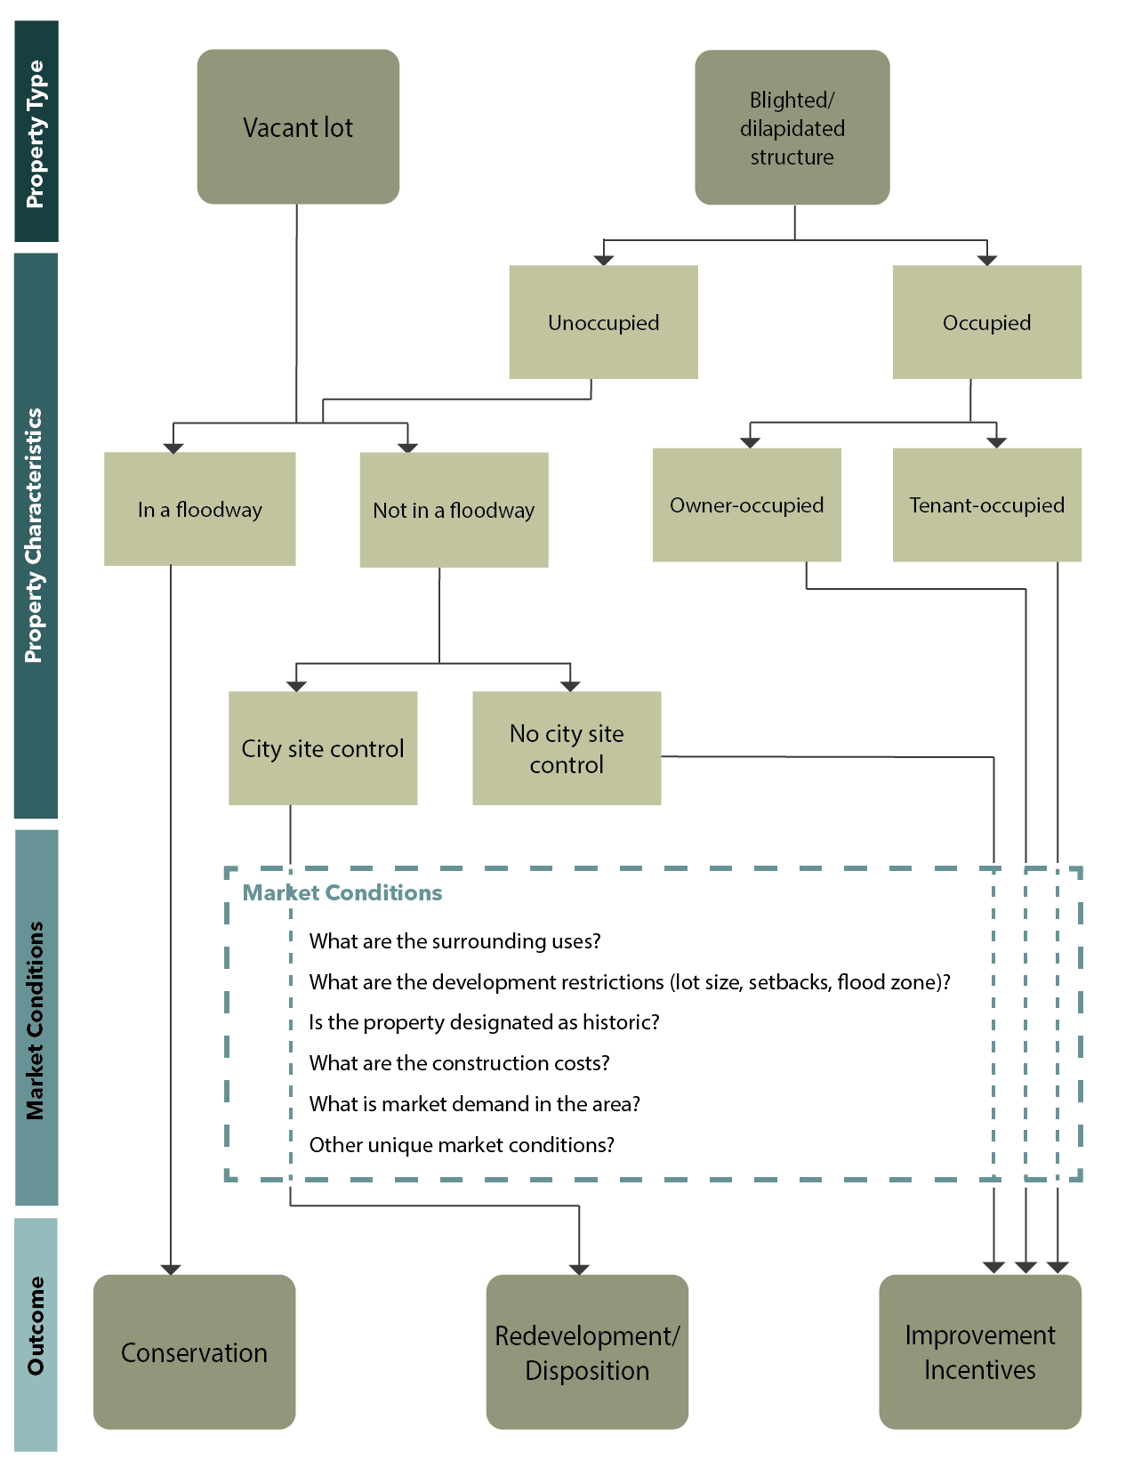
Recap
Property Assessment Results:
Improvement Approaches
Conservation: vacant properties in a FEMA-designated floodway (87)
Disposition/Redevelopment: adjudicated properties with short term potential for City site control (20)
Improvement Incentives: vacant and dilapidated properties that are privately owned (328)
Identify Strategic Areas
Property Inventory
Property Assessment
Recommendations
Notes:
Assessment results: properties are categorized by the most feasible improvement approach.
FEMA regulated floodway = the channel of a river or other watercourse and the adjacent land areas that must be reserved in order to discharge the base flood without cumulatively increasing the water surface elevation more than a designated height. FEMA coordination required for ANY work, even excavation.
City site control = Adjudicated property (for purpose of this study) = property of which tax sale title is acquired by a political subdivision.
Of the 134 adjudicated properties in Hammond, 113 are in the Enhancement Areas. Of the adjudicated properties in the EAs that were surveyed, 33 were identified as vacant and four were identified as dilapidated and unoccupied. EAs 0041 and 5032 were not surveyed but together contain 19 adjudicated properties. Not all adjudicated properties are vacant lots and/or blighted/dilapidated

Slide 7
Element III
City Goals
Return undeveloped and blighted residential properties to the housing market;
Rehabilitate, where feasible, the existing housing in identified areas;
Provide affordable housing that is compatible to the existing residential character of the surrounding neighborhood;
Capitalize on properties that could be redeveloped/developed for housing and provide surface infrastructure that would create more complete, connected, safe and attractive neighborhoods; and
Develop programs to promote homeownership and assist low-income and senior homeowners with property repairs and upkeep.
Identify Strategic Areas
Property Inventory
Property Assessment
Recommendations
Notes:
Data collected in Element I and II was used to develop and recommend strategies and programs that will help the City reach the goals.

Slide 8
Element III: Recommendations
Topic areas:
Identify Strategic Areas
Property Inventory
Property Assessment
Recommendations
Notes:
There are over 20 recommendations in the report with descriptions of each. Recommendation are meant to provide decision-support and not prescriptive
The recommendations represent ways to achieve the three property outcomes discussed a couple slide back: conservation, redevelopment, and improvement incentives
some of the recommendations could begin implementation without additional resources or staff, but many will require more.
Seeking additional resources from federal and state agencies and, in some cases, philanthropy will be important to achieving these goals and ensuring equitable development.
Keeping the property outcomes, goals, and strategies organized in advance will help with potential competitive funding applications and the establishment of fair and fiscally sound programs and policies.

Slide 9
Recommendations
Residential Property Regulatory and Administrative Governance
Lien foreclosures: LA Act 223 (2013) allows municipality to pursue lien foreclosures of property owned by unresponsive owners.
Adjudicated property: State law allows the City to obtain site control through quiet title.
Code Enforcement: Develop a written and succinct description of the property code enforcement procedures, including definitions of “blighted property” and steps of the condemnation process. Consider more aggressive enforcement through fines.
Identify Strategic Areas
Property Inventory
Property Assessment
Recommendations
Notes:
The first two recommendations on this slide require some legal work to set the City up correctly to pursue these options – Note these are likely only worth pursuing on vacant property and in the case of live foreclosures may only be legal on vacant property.
As CE policies are enhanced, they need to be consistent and support any ordinances proposed to transfer ownership of property

Slide 10
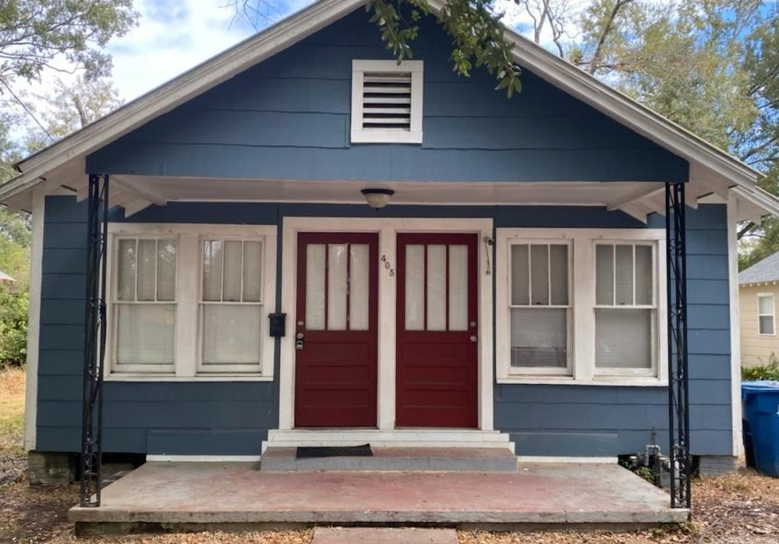
Recommendations
Affordable Single Family Home Development
Develop design standards for neighborhood-scale housing development
Revise zoning designations in the Enhancement Areas to attract development and reflect desired neighborhood-scale housing
Identify Strategic Areas
Property Inventory
Property Assessment
Recommendations
Notes:
Barriers to developing more affordable single-family housing development typically revolve around the cost. The median household income in Hammond is $31,250 (a decline of 3% since 2010) but the cost to build a SF home is ~210k. Estimates indicate that a household must make at least 70k/annually to afford a 30-year mortgage for a 210k purchase. The resulting challenge is that single-family construction is more expensive than the median income household in Hammond can afford. Savvy developers know this and will not risk building something that they cannot sell, unless they have subsidy or can build higher density to re-coup their costs.
Zoning code updates that prioritize the scale, massing and design to be appropriate for neighborhood context will offer developers more flexibility to build something that will be affordable, attractive and within the neighborhood context.
More generally, barriers to any new housing that is affordable may stem from single-use zoning standards that preclude "missing middle" housing (i.e., housing typologies between single-family and large multi-unit complex), parking requirements, or multi-layered regulatory processes. A thorough understanding of these barriers and options to counter them without giving up completely on what they currently offer to some residents who consider themselves single-family-only proponents, will allow the City to encourage more development at a form and design that is palatable to current residents.
Credit: Missing Middle Housing is a term coined by Daniel Parolek of Opticos Design in 2010. It’s a concept that has taken hold in the architectural and planning professions that highlights ways to provide more housing and more housing choices in sustainable, walkable places. About — Missing Middle Housing

Slide 11
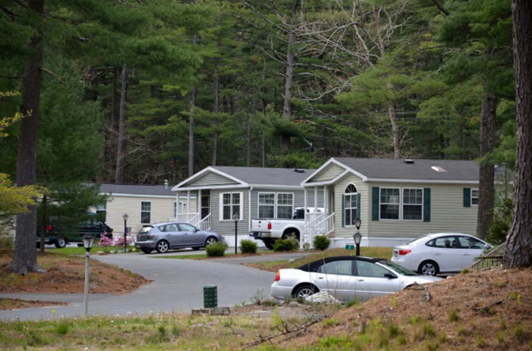
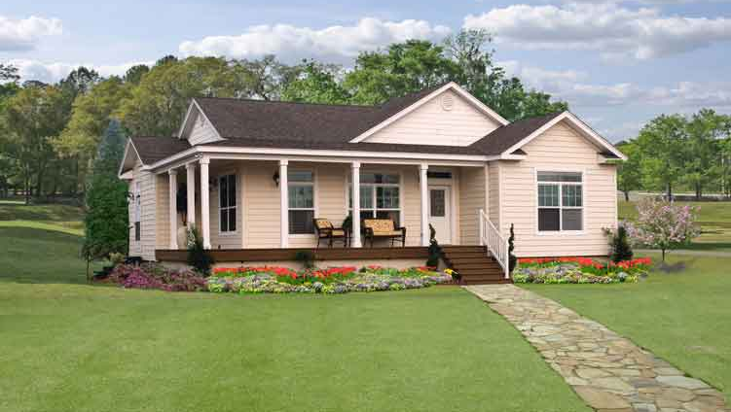
Recommendations
Affordable Single Family Home Development
Update zoning regulations to allow more housing types in Enhancement Areas such as modular homes and detached accessory dwelling units (ADUs)
Cranberry Village, Carver, MA
Modular home by Pratt Homes
Identify Strategic Areas
Property Inventory
Property Assessment
Recommendations
Notes:
Note, modular homes without a chassis are permitted in every zoning district. More generally, there is a perception problem with modular homes and they are often confused with manufactured/mobile homes of which they are are neither. (Mobile homes are now technically called “manufactured” homes)
Modular homes (aka prefabricated) do not ship fully assembled and it is not built on a chassis (manufactured homes are).
Modulars are built 80-90% completion in the factory before transport and is set on a foundation at the home site in pieces.
Once completed, a modular homes looks indistinguishable from a traditionally built home.
Modular homes are built to the exact local, state and regional building codes as homes built on-site
Modular homes receive the same treatment by banks as homes built on-site
“” can be built in any size, shape or floor plan
Modular homes take 4-8 weeks to construct in the factory

Slide 12
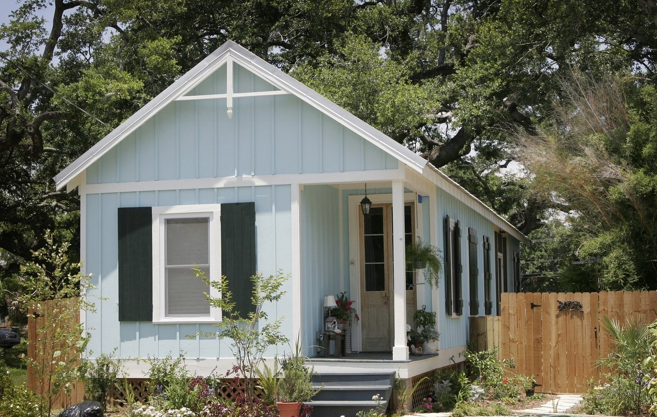
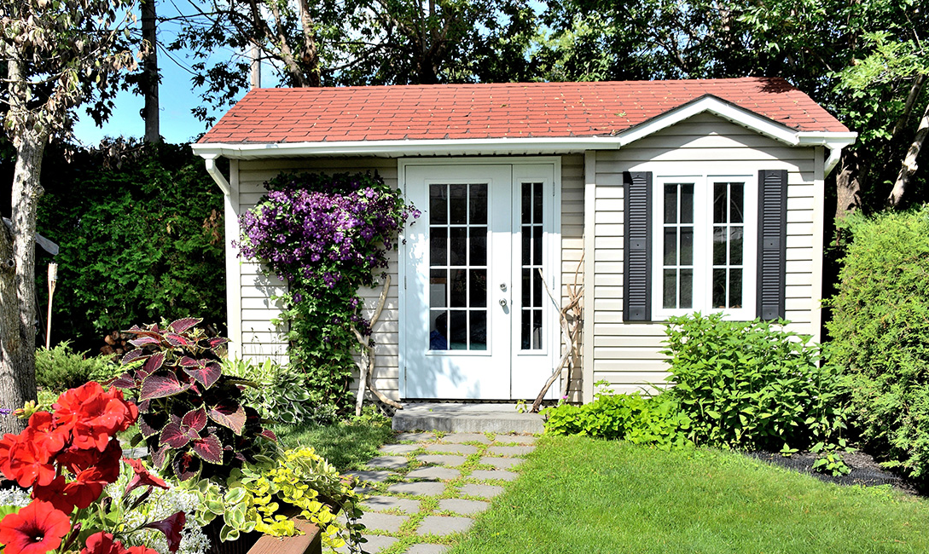
Recommendations
Affordable Single Family Home Development
Update zoning regulations to allow more housing types in Enhancement Areas such as modular homes and detached accessory dwelling units (ADUs)
Identify Strategic Areas
Property Inventory
Property Assessment
Recommendations
Notes:
As far as we can tell, Hammond does not allow for detached ADUs. ADUs are generally small, independent homes that are situated on the same lot as the principal home. These units are ideal for multi-generational families cohabitating, for seniors on a fixed income to help pay for upkeep, taxes or repairs and for student housing.
Consider ADUs in the Enhancement Areas at minimum and any neighborhoods adjacent to the University

Slide 13
Recommendations
Low-Income Homeowners and Buyers
Create targeted homeowner/buyer assistance programs:
Mortgage and/or down-payment assistance for eligible homebuyers
Home repair/rehabilitation program for eligible
Fill gaps that USDA loans cannot fill and work with a partner that can help with clearing title and income reviews, if applicable
Identify Strategic Areas
Property Inventory
Property Assessment
Recommendations
Notes:
Homeowners may be struggling to pay mortgage, taxes or upkeep
Homebuyers are unable to break into the market to own a home
80% AMI in Hammond MSA in 2021 is $48,400/4person household (MSA is Tangi parish)
80% AMI in New Orleans-Metaire MSA in 2021 is $56,100/4person household (includes Jefferson, Orleans, Plaquemines, St. Bernard, St. Charles, St. James, St. John the Baptist, and St. Tammany)
https://www.huduser.gov/portal/datasets/home-datasets/files/HOME_IncomeLmts_State_LA_2021.pdf

Slide 14
Recommendations
Neighborhood Revitalization and Stabilization Strategies
Develop public campaign to promote infill development in Enhancement Areas
Pursue housing and community development grants or forgivable loan programs
Establish a Lot Next Door Program (LND)
Establish a land bank to acquire and manage vacant properties for maintenance and re-use
Establish a program to address abandoned vehicles and illegal dumping
Establish a green infrastructure (GI) program to fund and/or finance rain gardens and low-maintenance landscapes in flood-prone areas
Identify Strategic Areas
Property Inventory
Property Assessment
Recommendations
Notes:
Neighborhood stabilization strategies aim to improve whole neighborhoods, not one property
These do not all have to be associated with subsidy.
LND – programs that encourage land maintenance through next door neighbors. Requires site control to implement
Housing and CD programs – could be from federal funding. Current grants department is well versed in options and advantages of pursuing various grants with the State or Federal agencies
Land bank = likely a quasi-gov org that could be chartered to have some powers that current gov agencies don't have--particularly through the disposition process.
GI program: much of Hammond is in FEMA floodplains and reducing nuisance flooding can help stabilize neighborhoods and create confidence in development.

Slide 15
Next Steps
Designate a City leader-champion for housing and blight remediation
Hire a city planner and/or a Community Development Director
Expand and empower the Housing Advisory Committee to work with the City on:
community engagement
an action plan to prioritize housing related policies and programs
fair housing access
Identify Strategic Areas
Property Inventory
Property Assessment
Recommendations
Notes:
City champion for blight and housing will help set clear objectives, coordinate and collaborate with existing city departments, determine and advocate for effective approaches, use existing resources and identify new ones (this may or may not be a new position)
If hired, a community development director would be an obvious champion for housing and blight remediation, but this position also have a more official role and greater capacity to identify and lead more than one department which will help with collaboration, managing housing goals and standards, oversee state and federal housing funding and compliance.
A city planner with public sector experience and preferably housing expertise would offer support and guidance to the City champion on housing and blight remediation. In addition to traditionl planning functions, this position will integrate city housing goals into formal planning documents, like the Comp Plan and Zoning code, maintain open dialogue with housing developers to understand shifting market conditions and site standard requirements.

Slide 16
Comments and Questions
Thank you!

